Slide 1
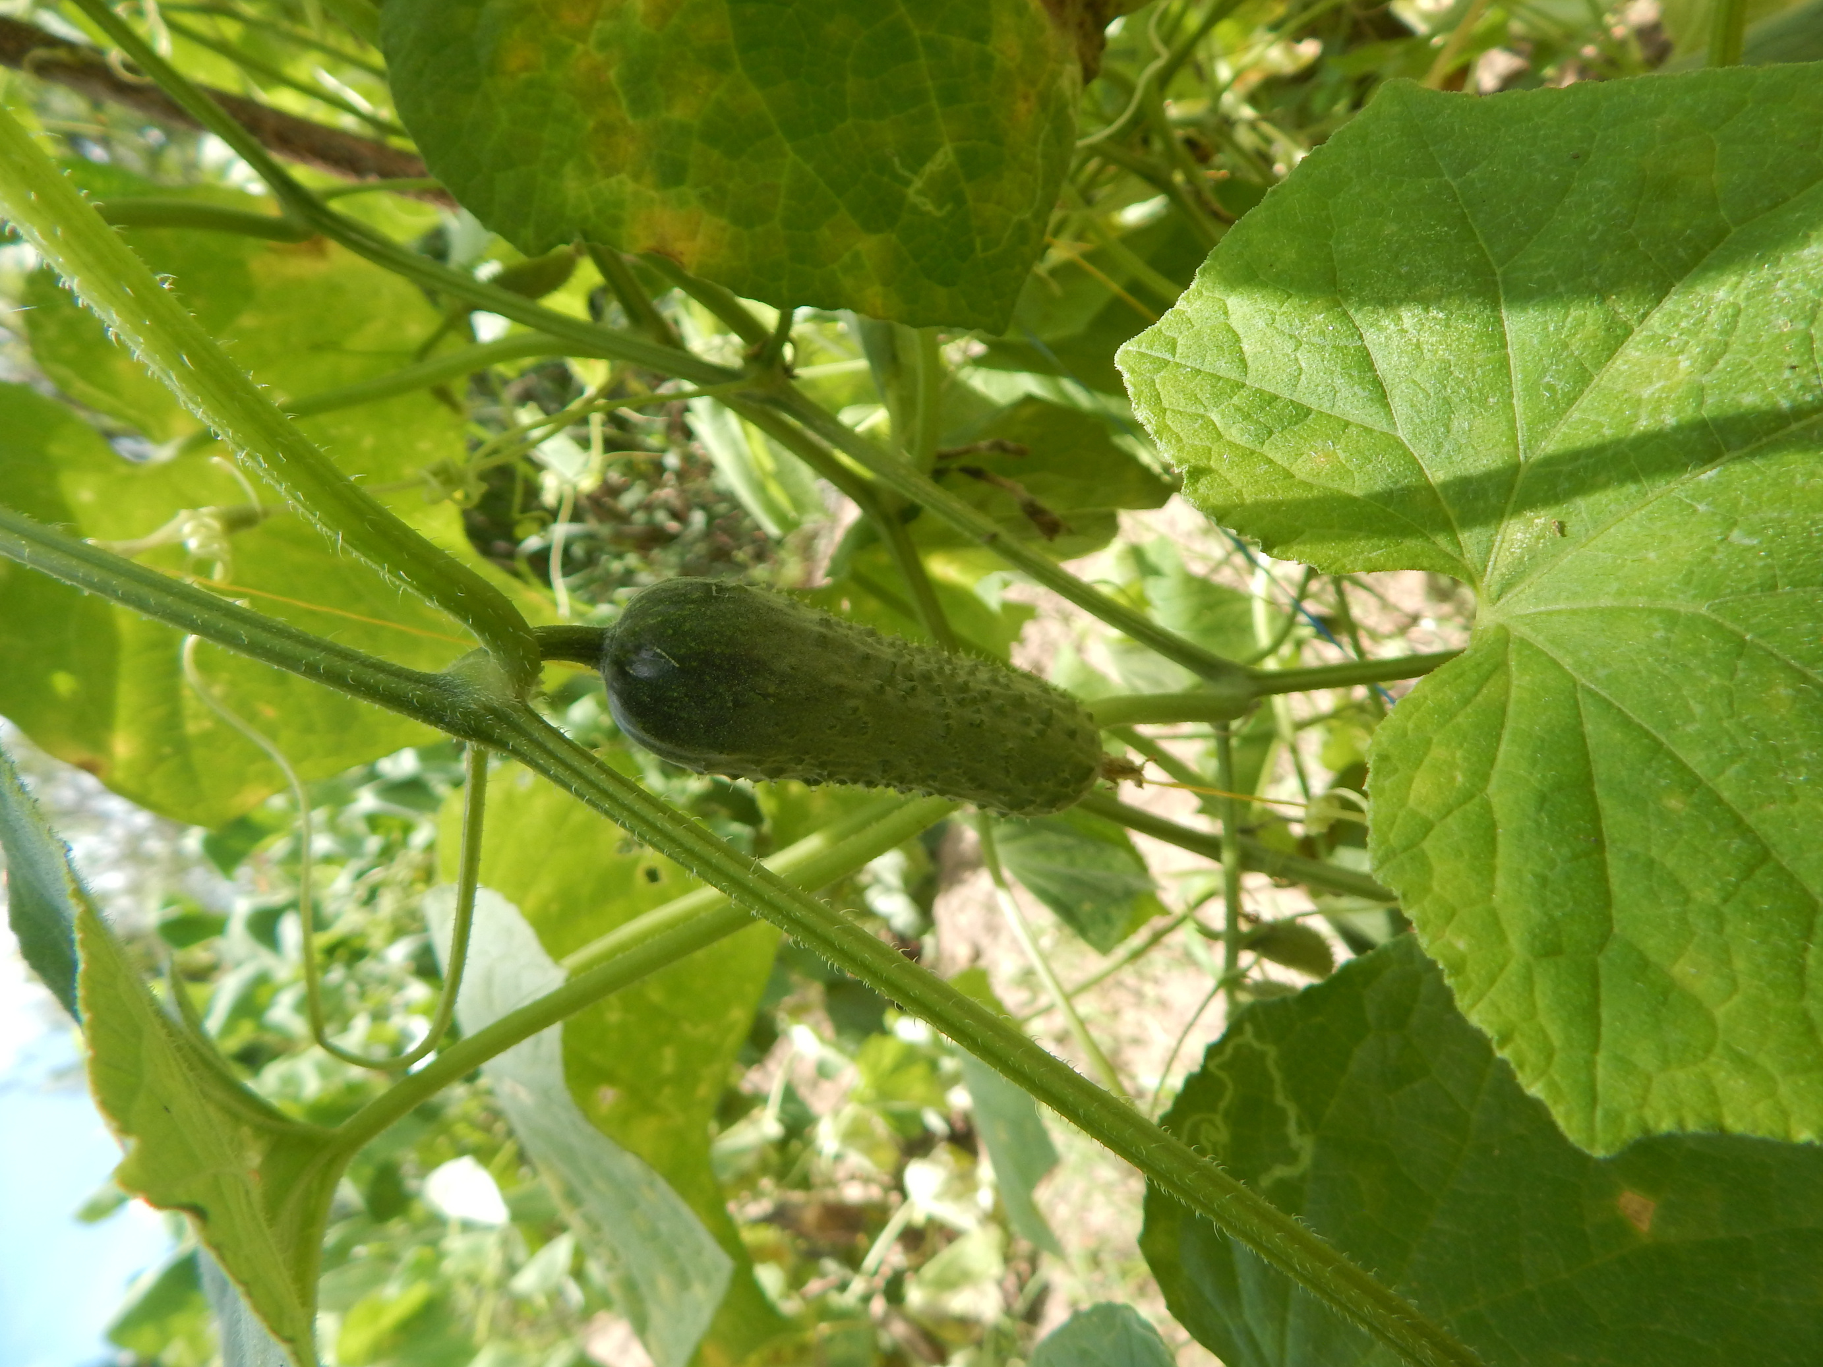
Synergetic Innovation in
Gherkin Cultivation
Project ID : R24-010
Ino Agri Mobile Application

Slide 2


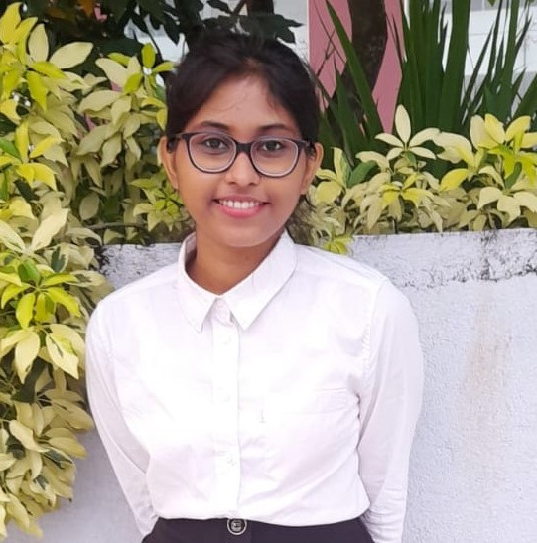


Meet Our Team !
Jinasena H.D.S.S
Dayarathna T.W.K.D.A.
Perera H.M.A.G
Nissanka K G T R K
IT21042560
IT21022388
IT 21045530
IT20254216

Slide 3
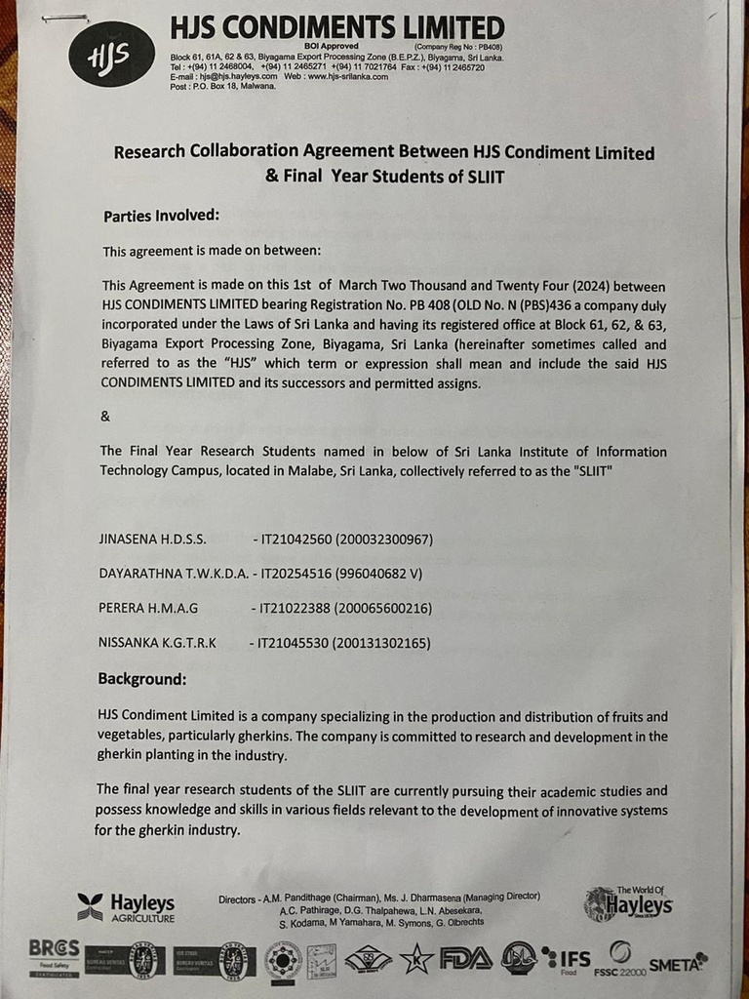
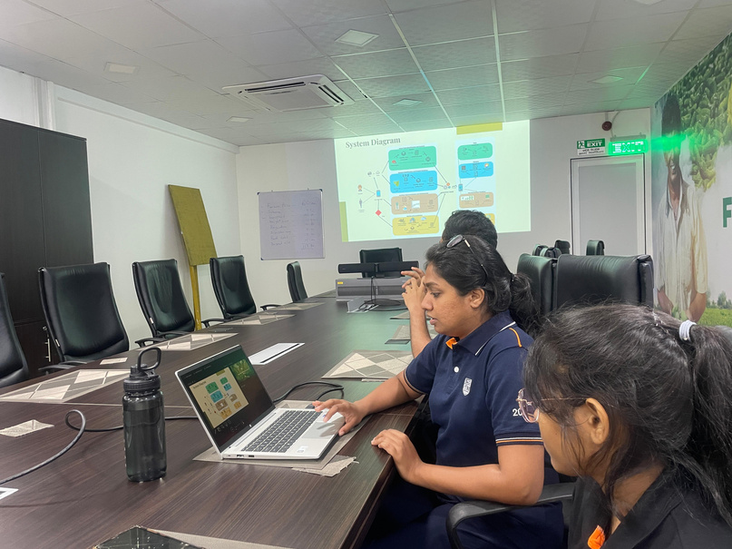
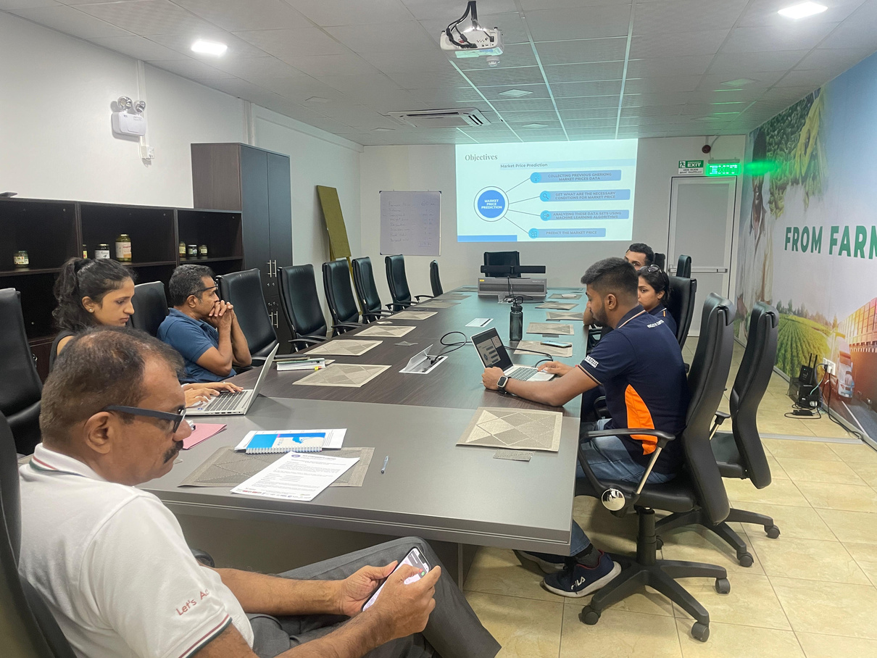
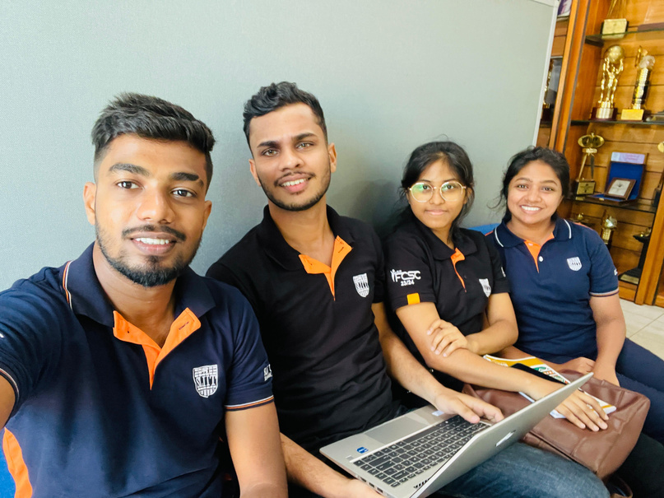
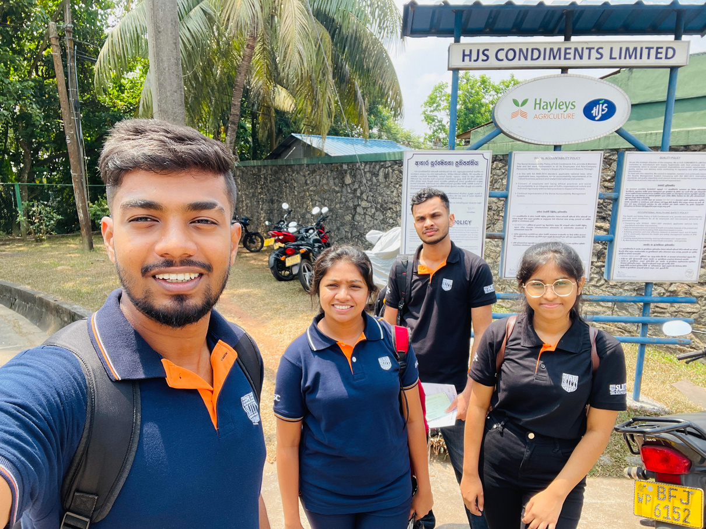
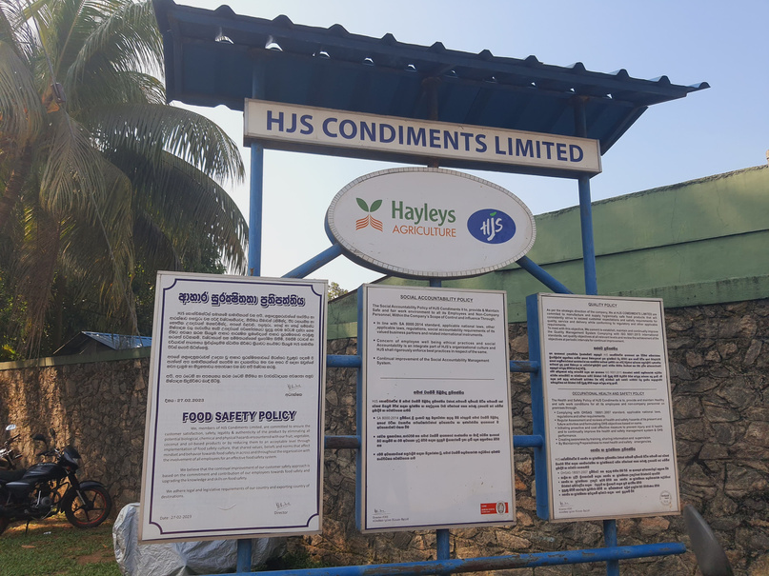
Snaps From The Field Visits @Heyleys Agro - Biyagama
Legal agreement

Slide 4
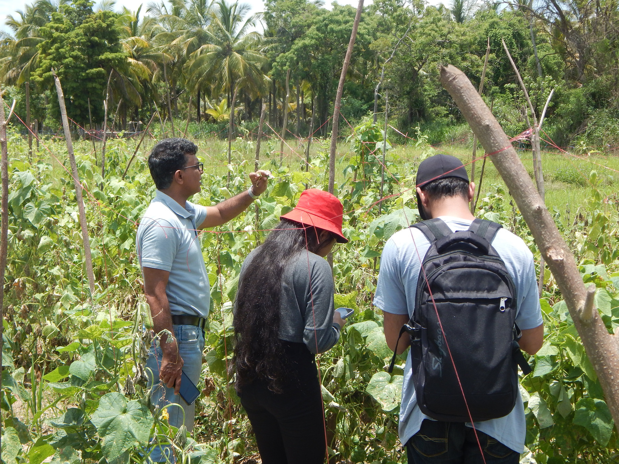
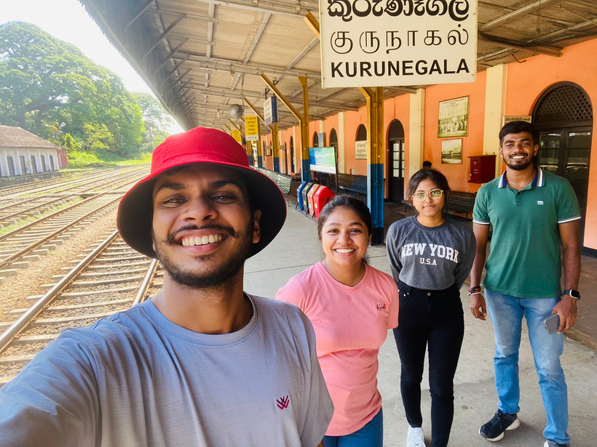
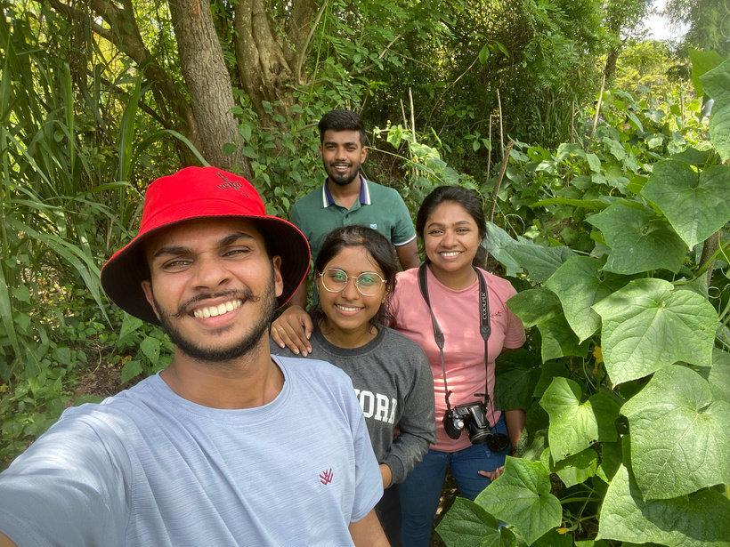
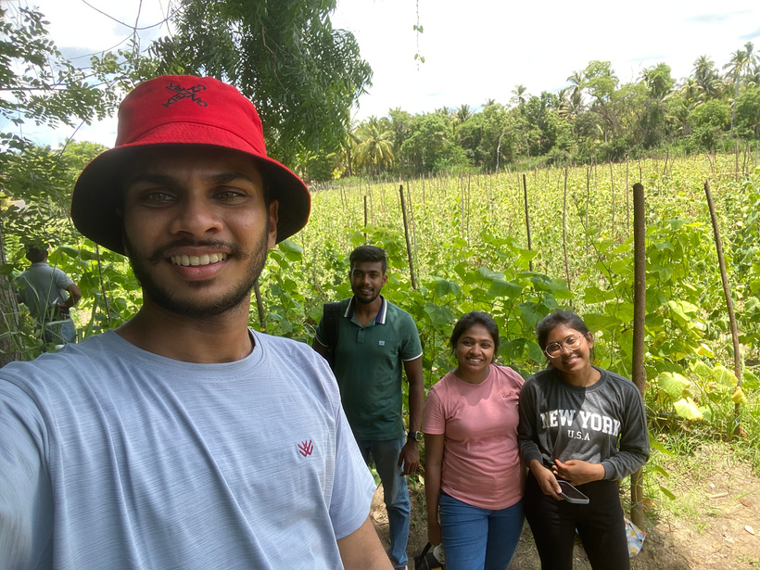
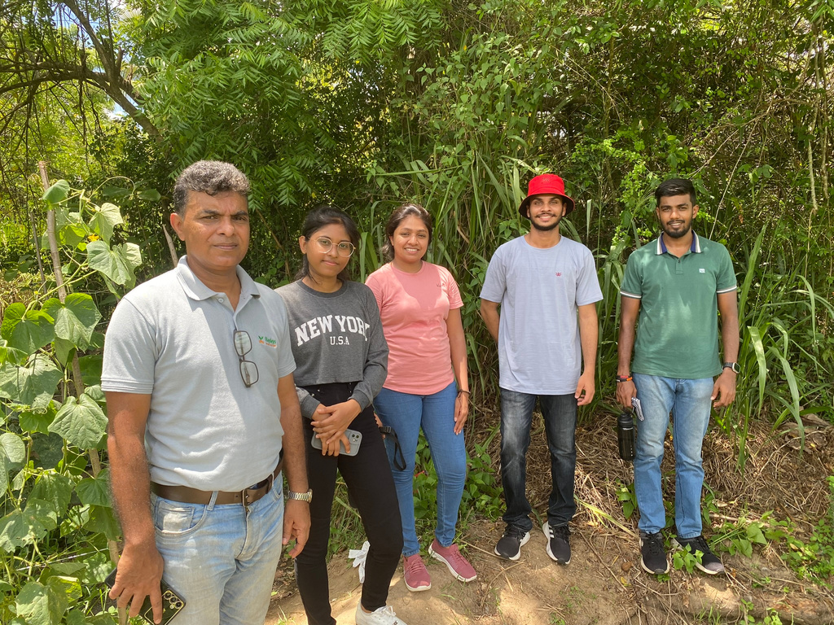
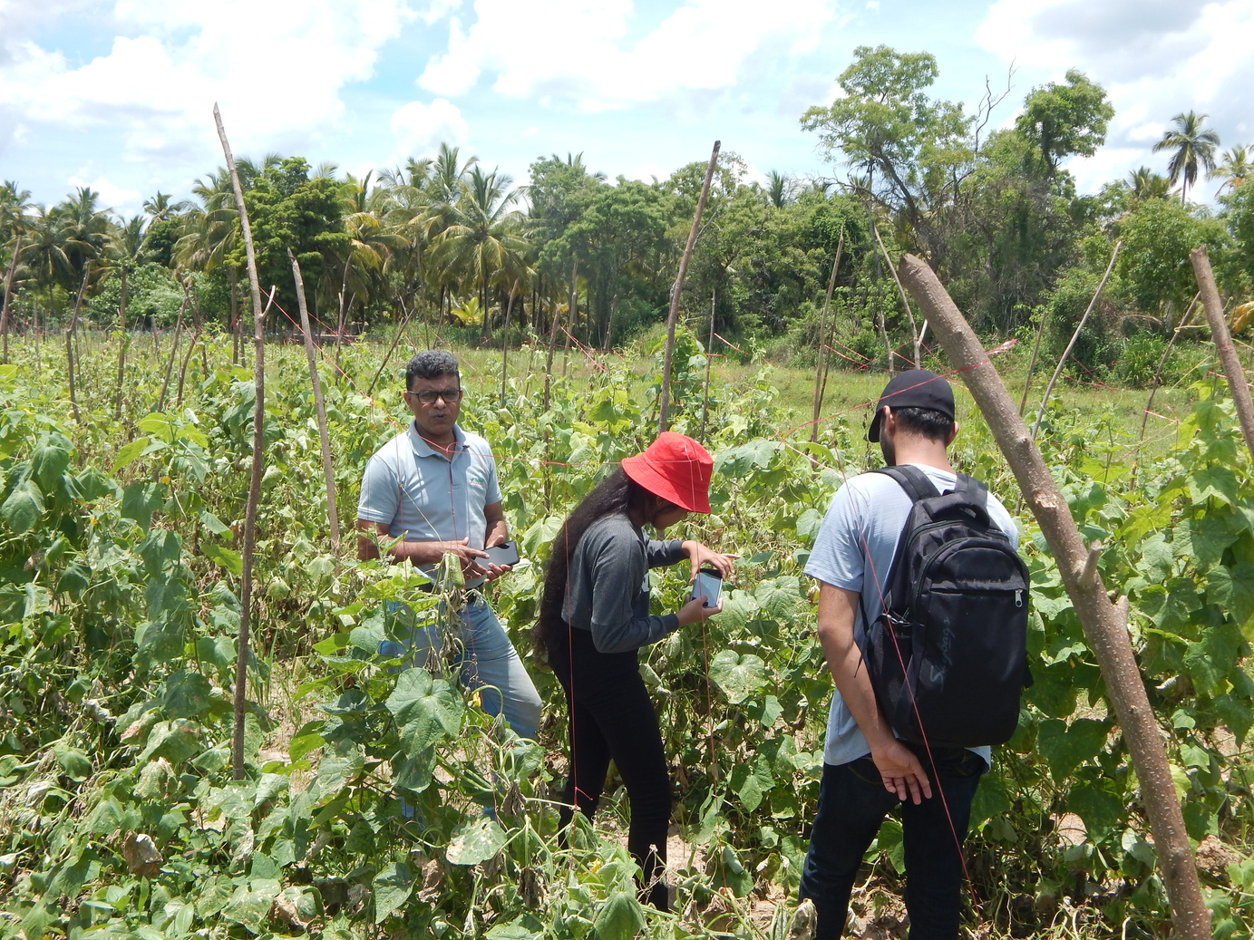
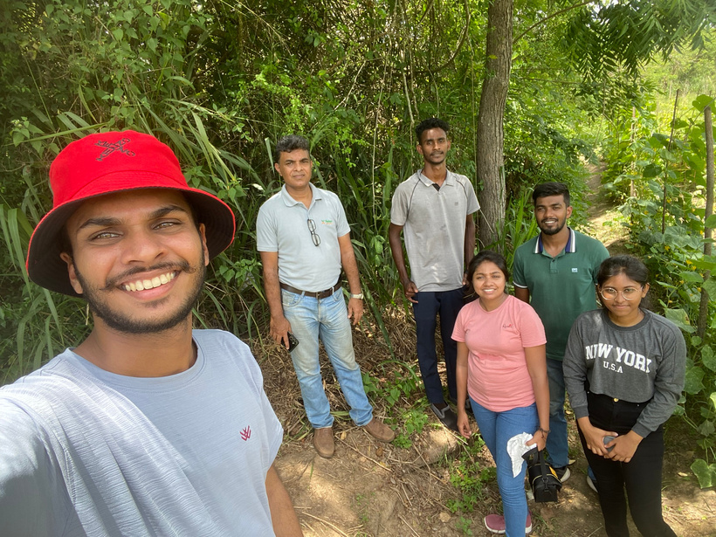
@Gherkin Farm - Nikawaratiya

Slide 5
Research Problem
The research problem directed on key challenges within Sri Lanka's gherkin industry.​
Issues include subjective, identifying diseases methods, insufficient pest identification, inaccurate cost price predictions, and inadequate fertiliser management according to the expected harvest. ​
Moreover, current farm planning lacks integration with immersive technologies, hindering optimal cultivation practices. ​
The research aims to address these challenges by proposing technical solutions that leverage machine learning, image processing, and virtual reality, ultimately enhancing the industry's efficiency and sustainability.

Slide 6
Research Objectives
Sub Objectives​
Pest control system with intelligent identification techniques for effective pest management.​
Harvest prediction system to reduce the gap between the expected and actual harvest by optimising the fertiliser combination. ​
Identify diseases and predict solutions for effective disease management strategies. ​
Predict the cost price for gherkins using acer of the land, Land preparation & Planting Materials, Fertilizer cost and other cost.
Main Objective
Transform the Gherkin planting Industry through an Innovative Multi-functional System​

Slide 7





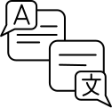

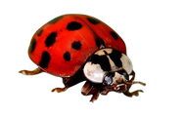






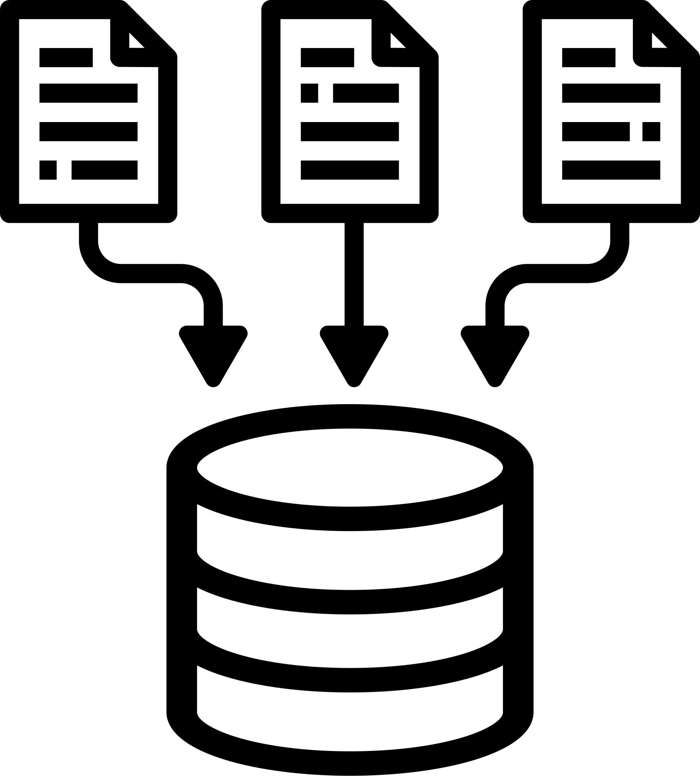
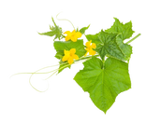
















System Diagram
Smart Pest Identification and Control System
Pest Solutions
Identify Pest
using CNN
Detect the pest
Augmented
Reality
Translation API
Pest Images
Solutions
re-Identify the Pest
Disease Solutions
Take
OR
Upload
Disease identification and Predict Solutions
Object Detection using Yolo
Show disease growth conditions using humidity and Environmental temperature
Dataset
Solutions
Identify disease
using CNN, InceptionV3, VGG19
Detect the
disease
Photos of leaf
Farmer
Fertilizer Stock Prediction and Maintenance
Identified Model
Ino Agri App
Predicted Actual Havest
Data set
Company Admins
Predict Actual Harvest
Best Fertiliser combination
Knowledge Base
If admin
Reports
ML Algirithms
Solutions
Weather forecast
True
Cost price prediction
Predicted Price
Land and Planting cost
Fertilizer cost
Fungicide and Others
Price changes
Invested Price
Area we can plant
Predict Cost
Machine learning algorithm
Solutions

Slide 8
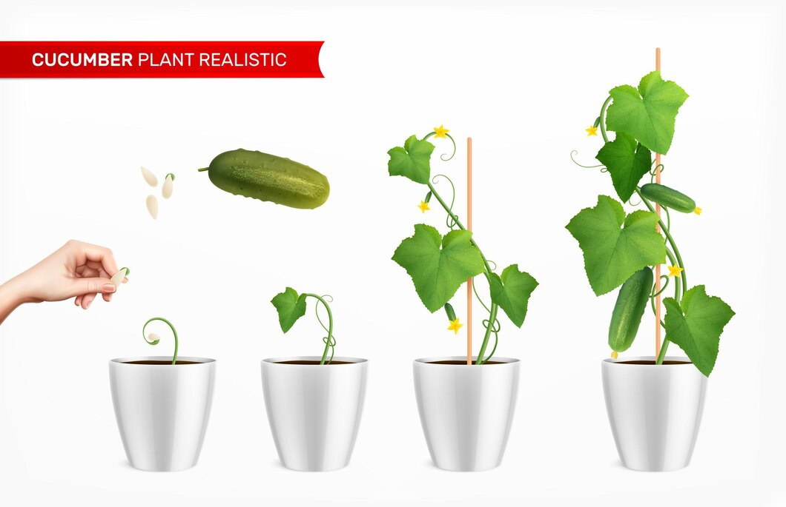
IT21042560 | Jinasena H.D.S.S
Specialization : Software Engineering
Smart Pest Identification and Control System

Slide 9
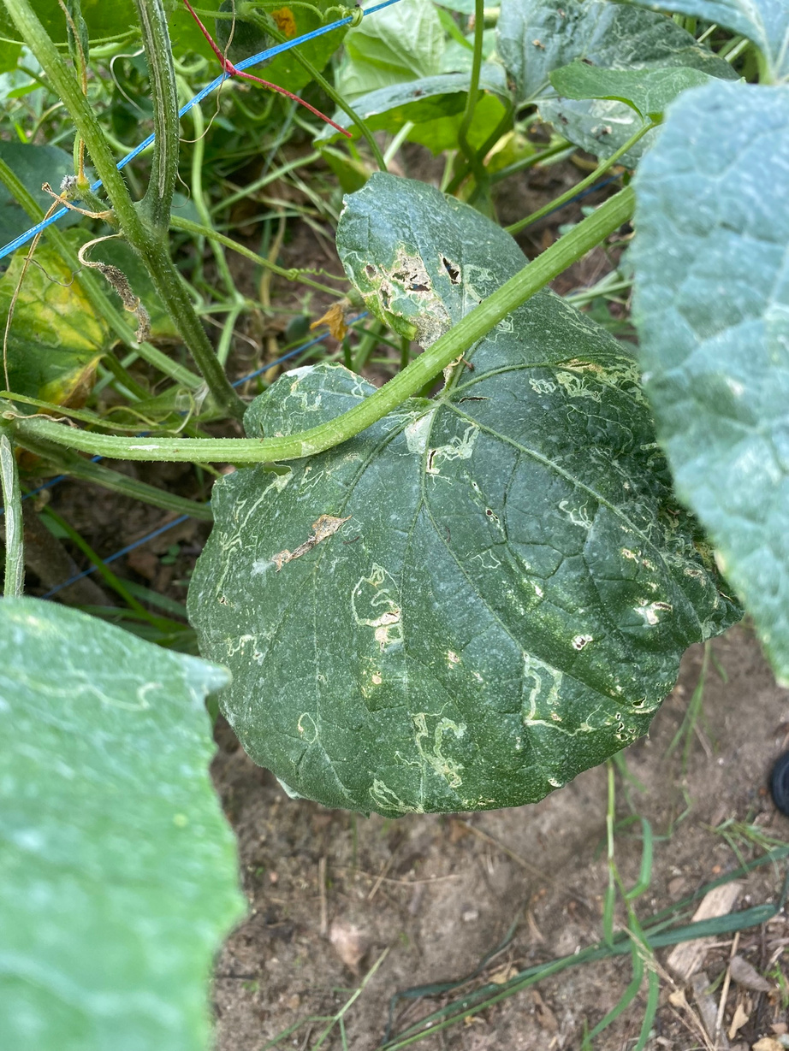
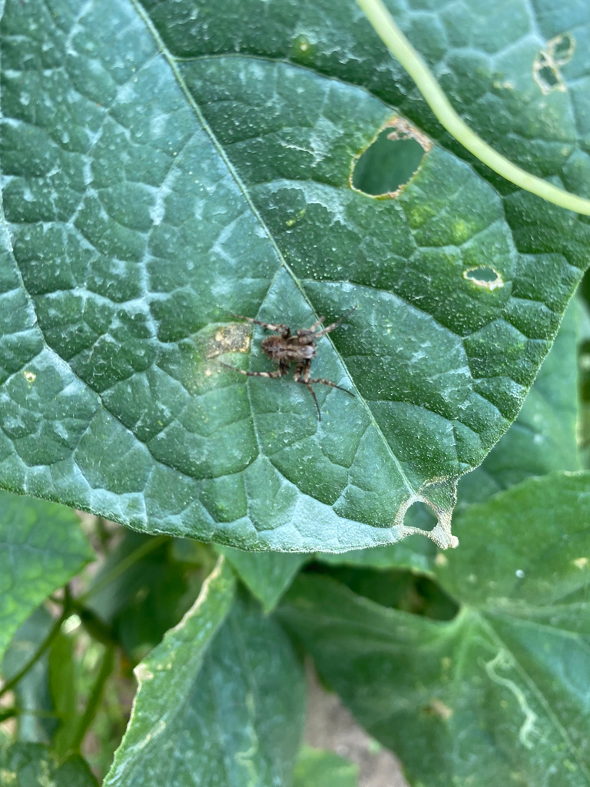
Introduction & Research Question
In the past, pest identification relied on visual observation and traditional methods struggle to predict the duration and speed of pest population growth and feeding habits.
pest control relied on experiential solutions. New farmers lack knowledge, leading to delayed identification and reduced harvests.
Farmers lacking technical knowledge struggle to adopt new technologies for pest management, hindering effective solutions and impacting overall harvest yields.

Slide 10




Objectives
Smart Pest Identification and Control System
IDENTIFICATION OF GHERKINS PESTS.
SPECIFIC
OBJECTIVE
PEST RE-IDENTIFICATION AND DETECTION
Smart Pest Identification and Control System
CREATE AR BASED PEST VISUALIZATION
PROVIDE TRANSLATE solutions to the pests

Slide 11

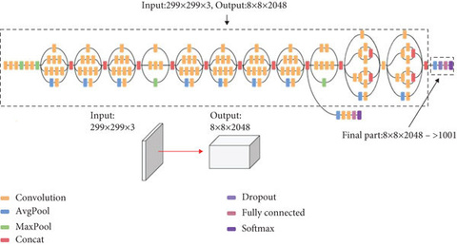



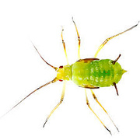
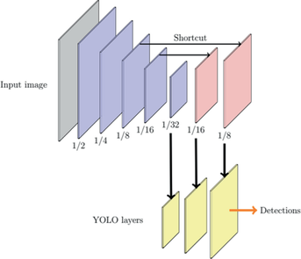


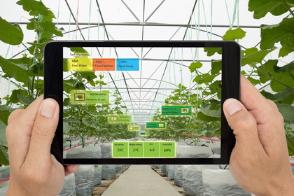

Methodology System
Diagram
Convert
image to
Base64 string
Classify Image using inception v3
OR
Take
Upload
Image Capturing
Pest Image
Client Interaction
Translated answer
Object Detection using YoloV8
Augmented reality view
Process the two model answers
Node Server
Flask Server

Slide 12


Methodology Evidence of Completion
Sub-Objective - 1
IDENTIFICATION OF GHERKINS PESTS.
Select the best YOLO version for accurate object detection
Extracting the pests in the leaf using the YOLO V8 algorithm
Data Collection, data pre-processing and data augmentation
Sub-Objective - 2
PEST RE-IDENTIFICATION AND DETECTION
Extracting the pests in the leaf using the Opencv and python libraries
Deploy the finalized model and python algorithms to the flask server

Slide 13

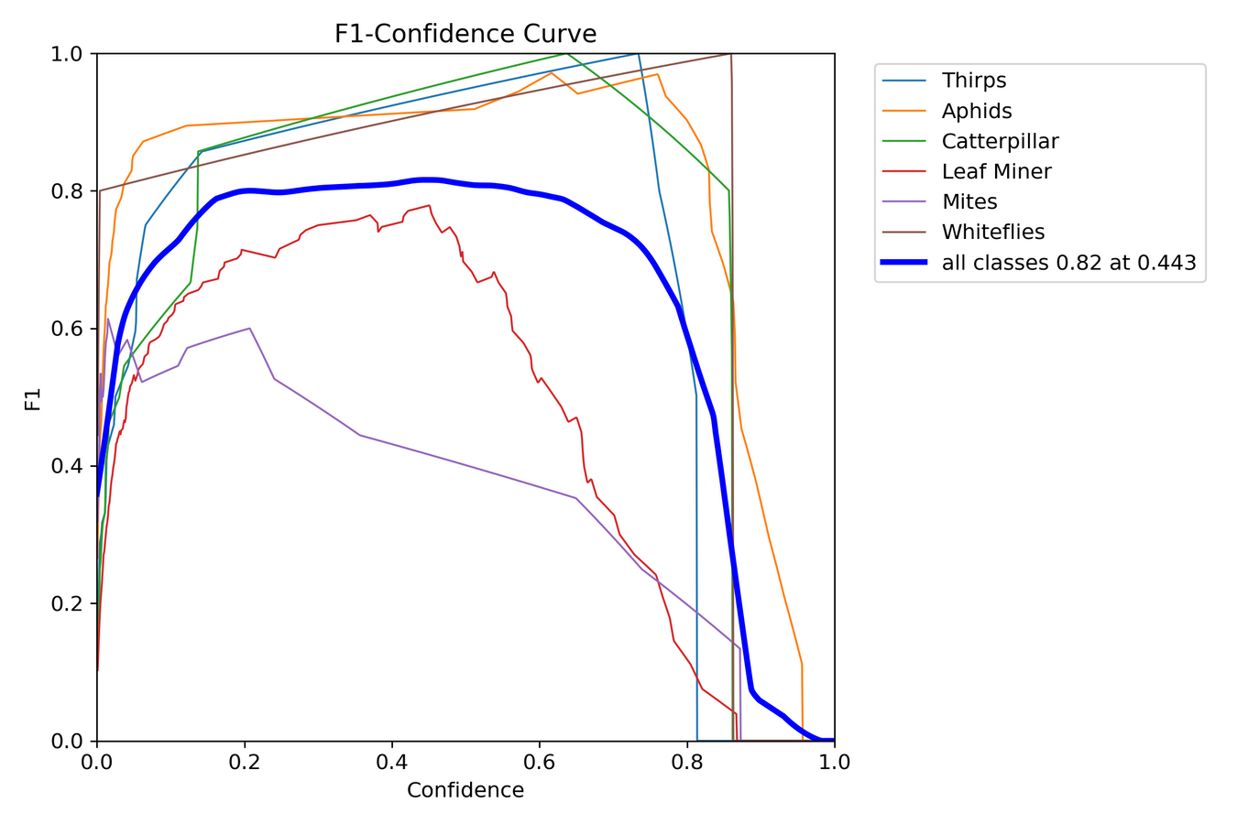

Sub-Objective - 1 [ Identification of Gherkins Pests]
Yolov3
Why not YOLOv3?
comparatively high training loss
Time-consuming
Why not try a faster and lightweight approach with less training loss?
Yolov8
Why YOLOv8?
Written in PyTorch
YOLOv8 is fast
Easy configuration
Small weight files for easy deployment
Yolov8 Model Confidence Chart

Slide 14
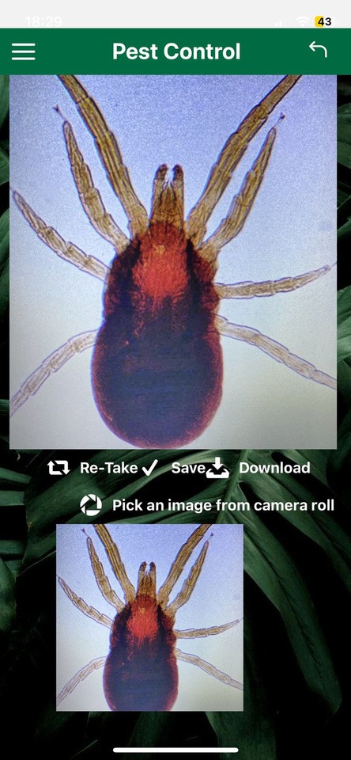
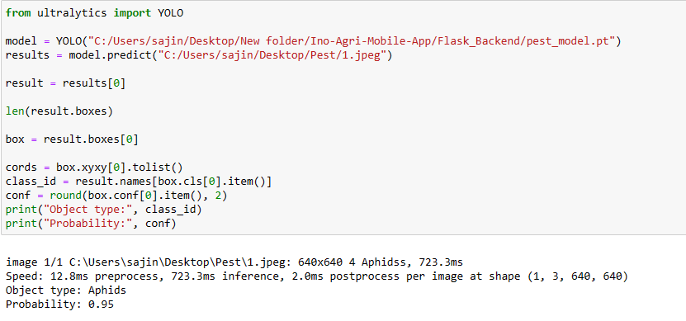
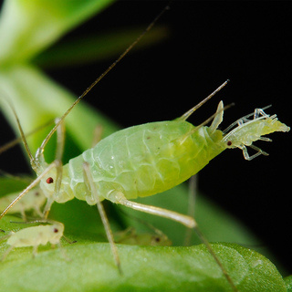
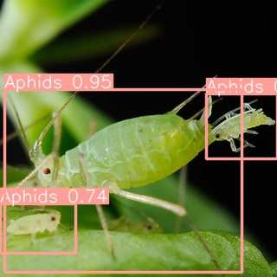
Yolov8 - Pest Detection
Get Input Image using mobile application
Test Image
Object Detected Image

Slide 15
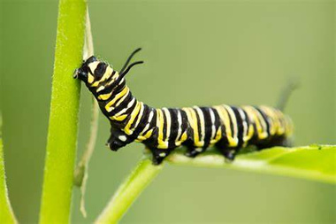
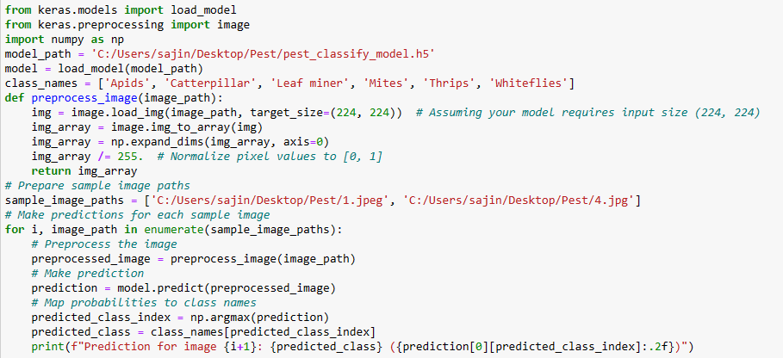
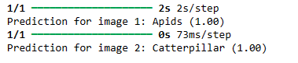
Sub-Objective - 2 [ Pest re-identification and detection]
inception v3
It has higher efficiency
It is computationally less expensive.
It uses auxiliary Classifiers as regularizes.
Input Images
Input Images
Output result
Predict Pest using inception v3

Slide 16
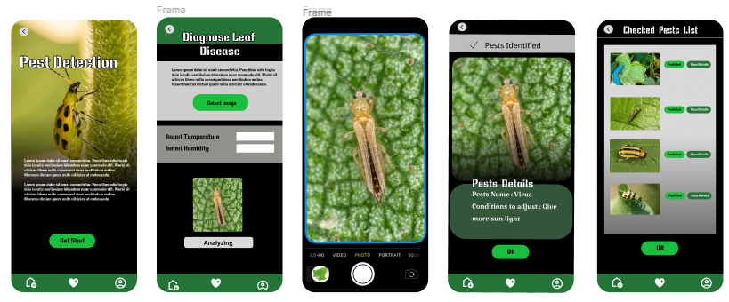
Frontend UI Wireframes

Slide 17

Completion and Future Works
Completion of the components
Future Implementations
Identification of Gherkins Pests.
Provide translated pest control solutions
Pest re-identification and detection
Provide augmented reality based pest visulaization.
Validate the two models output
Creating mobile application

Slide 18






Technologies and Algorithms
Technologies
Algorithms
Architecture
React Native
Expo
Python
Jupyter Notebook
Google Colab
Flask Server
Node Server
OpenCV
Yolov8
Inception V3

Slide 19
References
[1] Nitharshana Mahenthira, "Smart Pest Management: An Augmented Reality-Based Approach for an Organic Cultivation," in IEEE, Ankara, Turkey, 2021.
[2] Ascharya Soni , "Pest Identification and Control using Deep Learning and Augmented Reality," in IEEE, 2022.
[3] Hiroaki Kuzuhara, "Insect Pest Detection and Identification Method Based on Deep Learning," in Society of Instrument and Control Engineers of Japan (SICE), Chiang Mai, Thailand, 2020.

Slide 20
IT20254216 | Dayarathna T.W.K.D.A
Specialization : Software Engineering

Slide 21
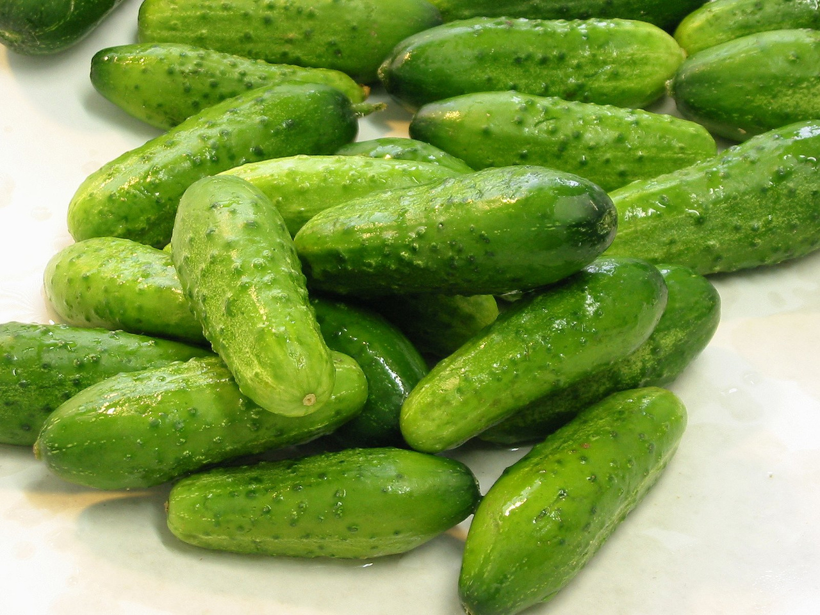
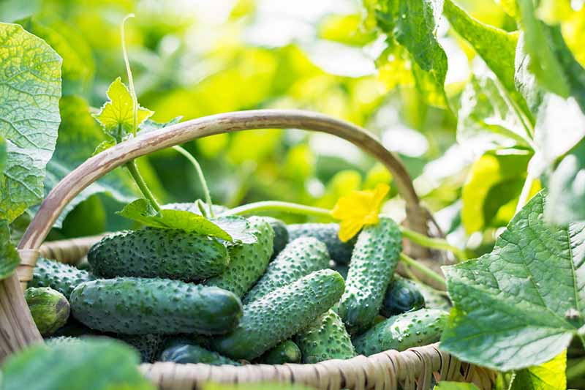
Introduction & Research Question
Traditional farming practices often involve uniform fertiliser application, leading to unpredictable harvest yields.
It makes a variance between expected and actual harvests incurs additional costs for farmers.
Introducing a predictive harvesting component can mitigate these challenges by providing insights into actual harvest outcomes and optimising fertiliser application.

Slide 22

Objectives
Actual Harvest Prediction And the Knowledge Base System
Build a machine learning model for harvest prediction
Analyse factors influencing harvest outcomes using factor analysis techniques.
SPECIFIC
OBJECTIVE
Actual Harvest Prediction
Create Knowledge Base chat bot
Provide a farmer friendly application

Slide 23
Methodology Evidence of Completion
Sub-Objective - 1
Data Collection and data pre-processing
Build a machine learning model for harvest prediction
Predicting Actual Harvest using Random forest regression algorithm
Select the most accurate model as the best model for the predictions
Deploy the finalized model and python algorithms to the flask server

Slide 24
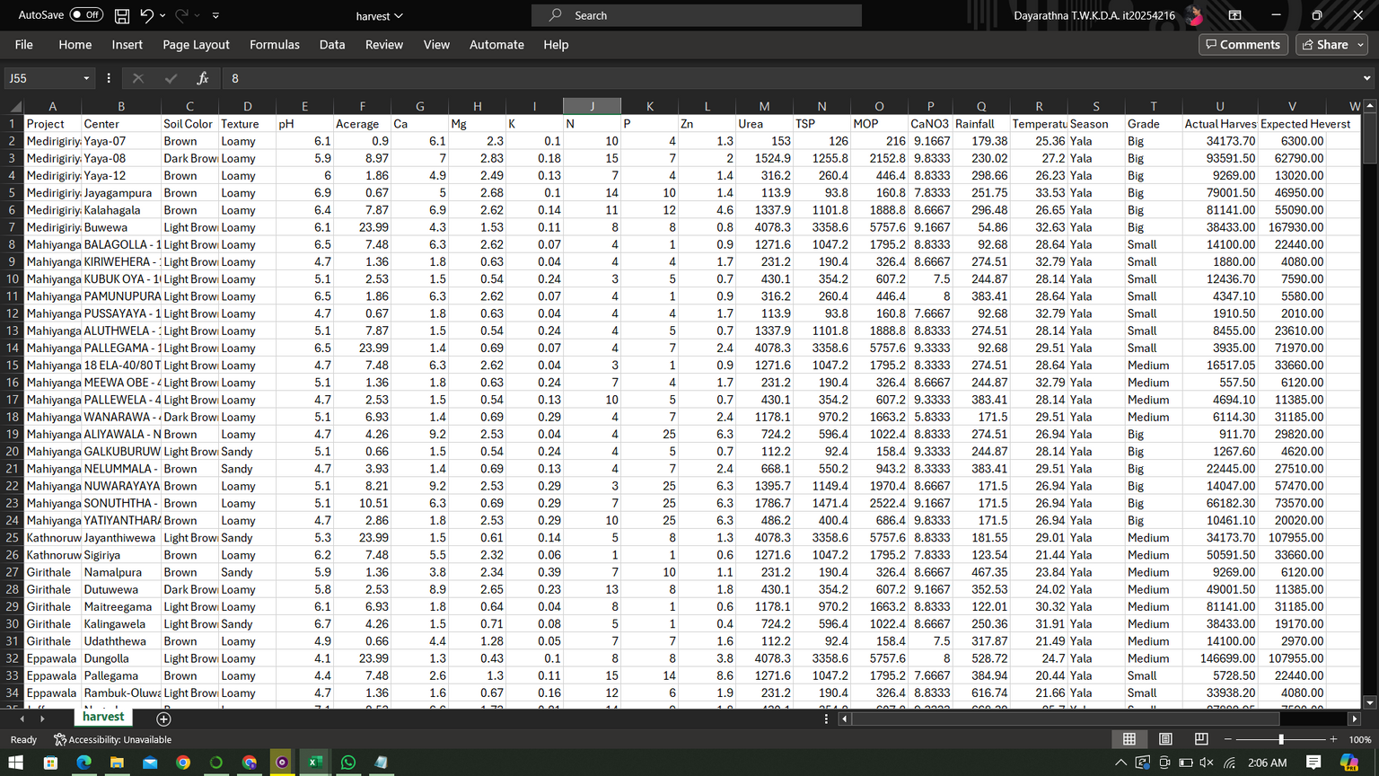
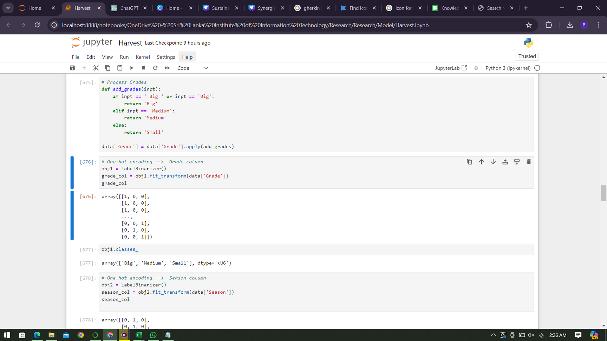
The Dataset
Preprocessing techniques
Removed unnecessary columns
Handle null values
Handled duplicate values
one hot encoding
Handled multi valued columns

Slide 25
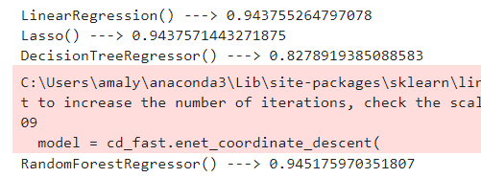
Selecting the best regression model for the prediction
Linear Regression
Lasso Regression
Decision Tree
Random Forest
The most accurate prediction was given by the Random forest regressor model

Slide 26
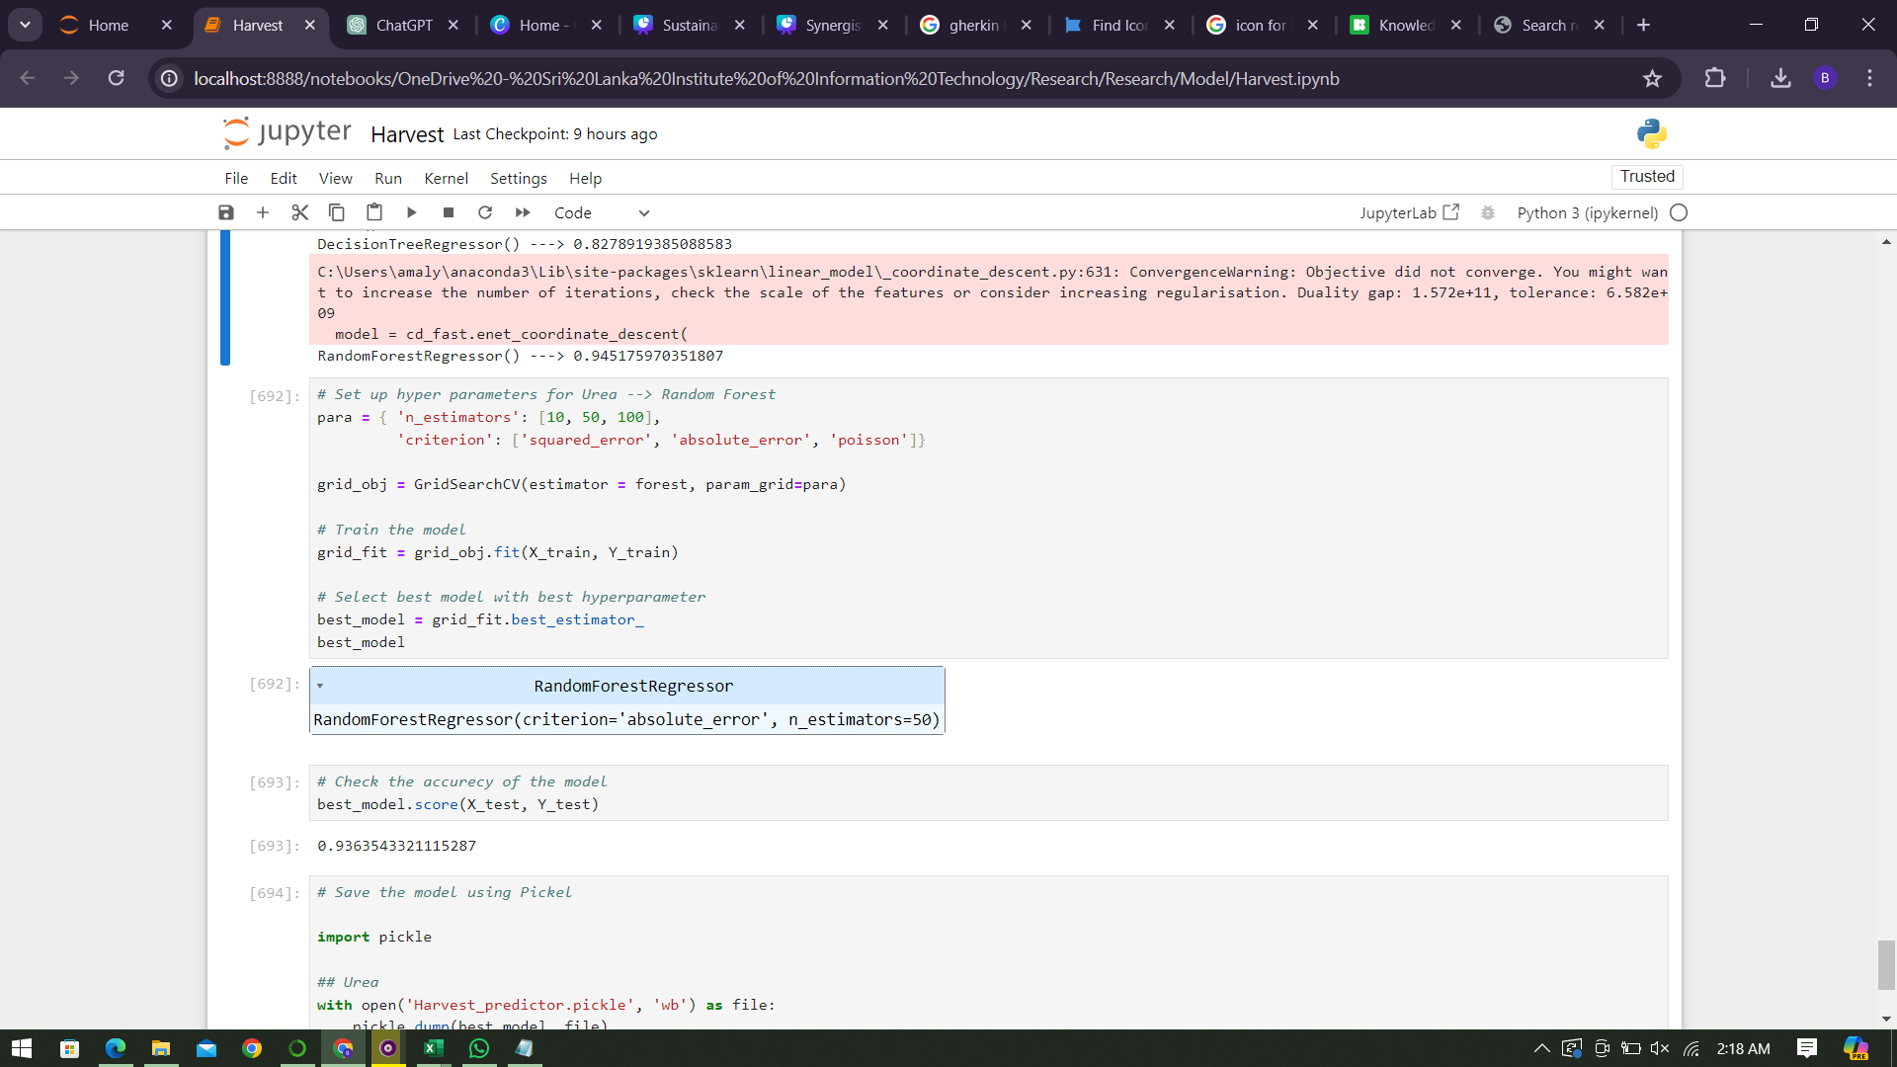
Model Creation
Training Accuracy : 93.64%

Slide 27
Completion and Future Works
Completion of the components
Future Implementations
Train the dataset using multiple models
Factor analysis of the influence features for harvest
Actual Harvest Prediction
Provide a knowledge base with a chat bot
Creating mobile application

Slide 28
Technologies and Algorithms
Technologies
Algorithms
Architecture
React Native
Expo
Python
Jupyter Notebook
Flask Server
Node Server
Random Forest regression
Lasso Regression
Linear Regression
Decision Tree
Ensemble learning architecture

Slide 29
References
1]K. Monika, B. Ramprakash, S. Muthuramalingam, and K. Mirdula, “Crop Fertilizer Prediction using Regression analysis and Machine Learning algorithms,” IEEE Xplore, Dec. 01, 2022. https://ieeexplore.ieee.org/document/10072846​
‌​
[2]K. P. K. Devan, B. Swetha, Puzhakkal Sruthi, and S. Varshini, “Crop Yield Prediction and Fertilizer Recommendation System Using Hybrid Machine Learning Algorithms,” Apr. 2023, doi: https://doi.org/10.1109/csnt57126.2023.10134662.​
​
[3]Sugantha Priyadharshini. P, Birundha. S, and Pavithra. R, “Deep Learning in Agronomic Forecast,” 2021 5th International Conference on Electronics, Communication and Aerospace Technology (ICECA), Dec. 2021, doi: https://doi.org/10.1109/iceca52323.2021.9675858.

Slide 30
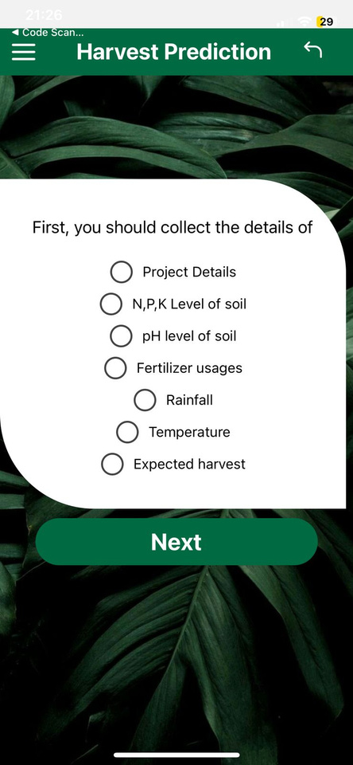
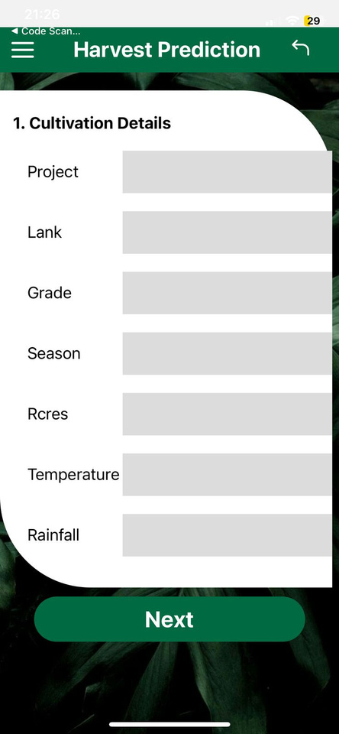
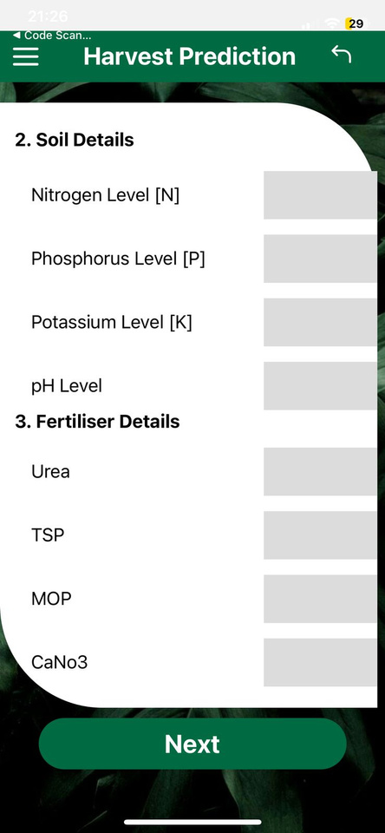
Frontend UI Wireframes

Slide 31
IT21022388 | PERERA.H.M.A.G
Specialization : Information Technology

Slide 32
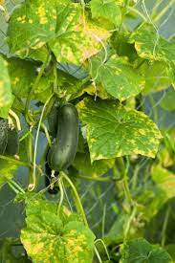
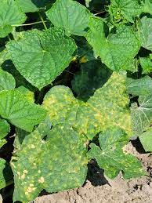
Introduction & Research Question
Farmers rely on visual appearance and keen observations to identify diseases affecting their plants.​
This process often involves experimentation, consultation with experts, and adaptation of management practices to suit the unique characteristics of each disease.
Farmers lacking technical knowledge struggle to adopt new technologies for disease idenfication and management, hindering effective solutions and impacting overall harvest yields.

Slide 33

Objectives
Disease Identification and Management System
Leaf disease classsification using CNN
Leaf diseases classification using CNN architecture
SPECIFIC
OBJECTIVE
Disease Identification and Management System
Choose best way to identify diseases using computer vision and object detection methods
Identify the disease growth

Slide 34
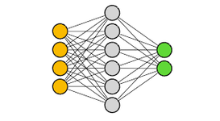
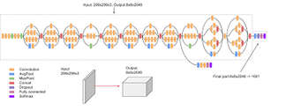
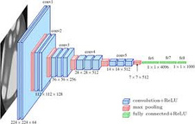
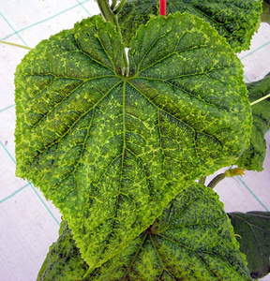
DIsease classification using CNN
Data pre-processing
convert to pixels
Methodology System
Diagram
DIsease classification using InceptionV3
DIsease classification using VGG19
Get the most accuracy model
OR
Leaf Image
Take
Upload
Temperature
Humidity
Image Capturing
Object Detection using Yolo
Client Interaction
Random Forest to dicide growth conditions using temperature and humidity
Give the output

Slide 35
Methodology Evidence of Completion
Sub-Objective - 1
Leaf disease classsification using CNN
Disease classification using CNN layers - Pooling layers , cnn layers
Data Collection, data pre-processing and data augmentation
Sub-Objective - 2
Leaf diseases classification using CNN architecture
Disease cllassification using Inceptionv3

Slide 36




Data Collection and Pre-Processing
Virus disease images Augmentation
Done the data pre-processing manualy
Remove blur images
Divide each categories separate folders
Downy Mildew
Virus
Healthy Leaves
Downy Mildew Disease images Augmentation

Slide 37



CNN and Inception V3
CNN
Inception V3
CNN Layes
Pooling Layer
CNN layer
CNN Architectures
Inception V3
VGG 19
loss: 0.6360
accuracy: 0.8500
loss: 0.5599
accuracy: 0.9304

Slide 38

CNN
Why use CNN?
CNNs offer a powerful and adaptable framework for classifying diseases on cucumber leaves.
CNNs can automatically extract relevant features from images of cucumber leaves, capturing disease-related patterns, textures, and structures without manual feature engineering.
CNNs can adapt to different lighting conditions, orientations, and variations in leaf appearances.
Input Image of Downy Mildew
Downy Mildew as output result
Predict disease using CNN

Slide 39

InceptionV3
Why use InceptionV3?
Inceptionv3's multi-scale feature extraction
transfer learning capability, robustness to variability.
Interpretability make it a strong candidate for classifying diseases on cucumber leaves
Offering improved accuracy and performance in disease diagnosis tasks.
Input Image of Downy Mildew
Virus as output result
Predict disease using InceptionV3

Slide 40

Frontend UI Wireframes

Slide 41

Completion and Future Works
Completion of the components
Collect the data and clean the dataset and make dataset
Leaf Diseasse classification using CNN
Leaf Diseasse classification using CNN Architecture
Future Implementations
Choose best way to identify diseases using computer vision and object detection methods
Identify the disease growth

Slide 42
Technologies and Algorithms
Technologies
Architecture
Inception V3
CNN
React Native
Expo
Python
Jupyter Notebook
Google Colab
Flask Server
Node Server
OpenCV

Slide 43
IT21045530 | Nissanka K G T R K
Specialization : Information Technology

Slide 44

Introduction
This function is utilized to predict the cost associated with producing gherkins.
Using various factors such as Land and Planting cost, Fertilizer cost, Insecticide, Fungicide, and Others.
The solution aims to continuously refine predictive models using machine learning and statistical techniques, with a time forecasting algorithm for dynamic adjustments based on real-time market conditions.

Slide 45

Objectives
Cost Prediction
COLLECTING PREVIOUS GHERKING PLANTING COST DATA
GET WHAT ARE THE NECESSARY CONDITIONS TO PREDICT COST
COST PREDICTION
ANALYZING THESE DATA SETS USING MACHINE LEARNING ALGORITHMS
PREDICT THE COST

Slide 46






Methodology System
Diagram
Farmer
Ino Agri App
Pervious data sets of prices
Apply machine learning and statistical techniques to process data
Insert Necessary data
Land and Planting cost
Fungicide and Others
Fertilizer cost
conditions for cost
Predict the cost price

Slide 47

Technologies and Algorithms
Technologies
Algorithms
React Native
Python
Jupyter Notebook
Linear regration
Lasso regration
Decision tree
Random forest

Slide 48

Frontend UI Wireframes

Slide 49


Model creation using Jupyter notebook
Install and import libraries and csv
data set file
Remove null values data preprocessing and cleaning

Slide 50


Appling linear regration, lasso regration ,decision tree,
random forest algorithems and check the accuracy of the model
Divide data set into X , Y

Slide 51

Completion and Future Works
Completion of the components
Future Implementations
Colecting data set of Ghurkin planting cost
Add new columns to the data set and get more accuracy
Remove null values data preprocessing and cleaning
Add new functionalities to the system
Applying algorithms and get accuracy
Modify UI to more user friendly
Creating mobile application.

Slide 52
References
[1] Xiong Y , Ming Y , Liao X , et al. Cost prediction on fabricated substation considering SVM via optimized QPSO [J]. Thermal Science, 2020, 24:10-10.
[2] Chen S . Construction Project Cost Management and Control System Based on Big Data[J]. Mobile Information Systems, 2022, 2022:1-7.
[3] S. Tayefeh Hashemi, O. M. Ebadati, and H. Kaur, “Cost estimation and prediction in construction projects: a systematic review on
machine learning techniques,” SN Applied Sciences, vol. 2, no. 10. 2020, doi: 10.1007/s42452-020-03497-1.

Slide 53
Thank you.

